Slide 1




NEXT GEN EMPLOYABILITY PROGRAM
Creating a future-ready workforce
Team Members
College Name
Student Name :S.Pratheesha
Student ID : au960221104083
Arunachala College of Engineering for Women

Slide 2

CAPSTONE PROJECT SHOWCASE
Project Title
Car Rentals Application with Django Framework
Abstract | Problem Statement | Project Overview | Proposed Solution | Technology Used | Modelling & Results | Conclusion

Slide 3
Abstract
This project aims to develop a comprehensive car rental application using the Django framework, catering to the needs of both customers and administrators. The application will facilitate seamless browsing, booking, and management of car rentals, providing users with a user-friendly interface and robust functionality. Users will be able to create accounts, search for available cars based on their preferences, make reservations for desired dates, and manage their bookings. Administrators will have access to backend functionalities to manage car listings, user accounts, and analyze rental statistics. Leveraging Django's powerful features, the application will prioritize security, scalability, and ease of use to deliver a reliable and efficient solution for car rental services
Source :

Slide 4
Problem Statement
"Develop a web-based car rental application that allows users to browse and rent cars for various durations. Users should be able to create accounts, search for available cars based on criteria such as location, date, and vehicle type, view car details including pricing and availability, reserve cars for specific dates, and manage their reservations. Additionally, administrators should have the ability to add, remove, and update car listings, manage user accounts, and view rental statistics. The application should prioritize usability, security, and scalability while leveraging Django's built-in features for authentication, database management, and templating."
Source :

Slide 5
Project Overview
The car rental application aims to provide users with a user-friendly platform to rent cars for their transportation needs. Built using the Django framework, the application allows users to register and log in to their accounts. Once logged in, users can search for available cars based on location, date, and other preferences. The application displays detailed car listings, including information such as make, model, pricing, and availability. Users can select their desired car and make bookings for their desired rental period.To ensure secure transactions, the application integrates a payment gateway, allowing users to complete their bookings with ease. Additionally, an admin panel is available to manage various aspects of the rental service, including car listings, bookings, and user accounts. This admin panel provides efficient management and oversight of the car rental operations.By leveraging the power of Django, the car rental application offers a seamless and intuitive experience for both users and administrators. It combines functionality, convenience, and security to create a reliable platform for car rentals.
Source :

Slide 6
Proposed Solution
.
The car rental application will be developed using the Django framework to provide a scalable, secure, and efficient solution. Here's an outline of the proposed solution:
User Interface Design: Design an intuitive and responsive user interface using HTML, CSS, and JavaScript, ensuring ease of use across devices.
User Authentication and Authorization: Implement user registration and login functionality using Django's built-in authentication system. Utilize authorization mechanisms to restrict access to certain features based on user roles.
Car Listings Management: Develop an admin panel for administrators to manage car listings. This includes adding new cars, updating existing listings, and removing outdated ones.
Source :

Slide 7
4. Booking System: Implement a booking system where users can search for available cars based on criteria such as location, date, and vehicle type. Users should be able to make reservations for specific dates and times.
5. User Profile Management: Allow users to manage their profiles, view booking history, and update personal information.
6. Payment Integration: Integrate a payment gateway to facilitate secure online payments for car rentals.
Source :

Slide 8
7. Email Notifications: Send email notifications to users for booking confirmations, reminders, and updates.
8. Analytics and Reporting: Provide administrators with insights into rental statistics, such as the number of bookings, revenue generated, and popular car models.
9. Security Measures: Implement security measures to protect user data, including encryption of sensitive information, prevention of SQL injection, and cross-site scripting (XSS) protection.
10. Scalability and Performance: Design the application with scalability in mind, ensuring it can handle a growing number of users and car listings. Optimize performance by minimizing database queries and leveraging caching mechanisms.
Source :

Slide 9


Technology Used
Front-end
Back-end
Source :

Slide 10
Modelling & Results
To build a car rental advertisement system with Django, you'd define models for key entities like Car, Rental, and Customer, specifying their attributes and relationships. For example, the Car model might include fields for make, model, and availability status, while Rental could track details like start and end dates, along with associated customer information. For showcasing results, you'd develop views and templates to present data such as rental bookings, revenue generated, and customer feedback. Django's ORM would facilitate database interactions, while its admin interface could streamline management tasks. With Django's robust framework, you can create a comprehensive car rental platform tailored to your specific needs.
Source :

Slide 11
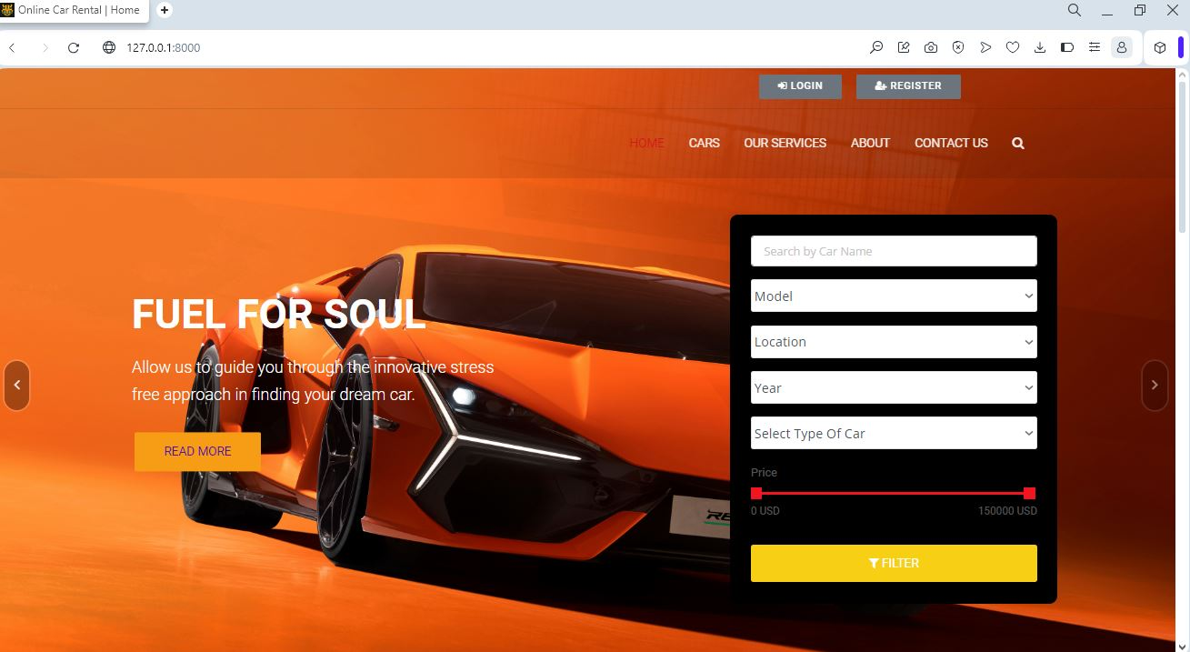
Homepage

Slide 12
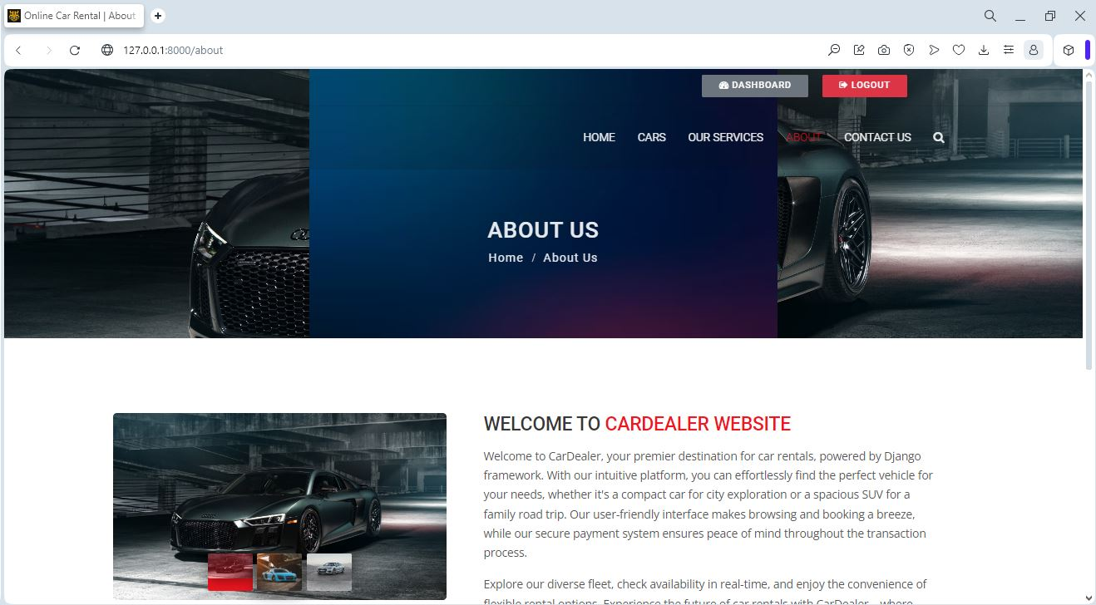
About-Us-Page

Slide 13
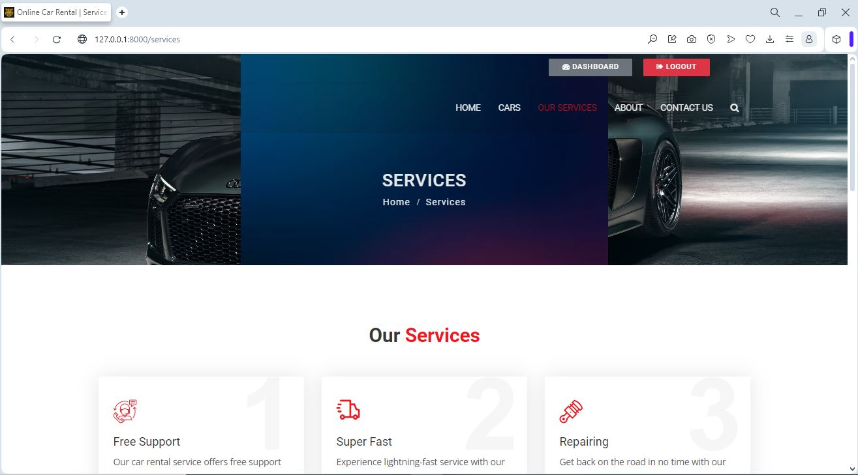
Service-Page

Slide 14
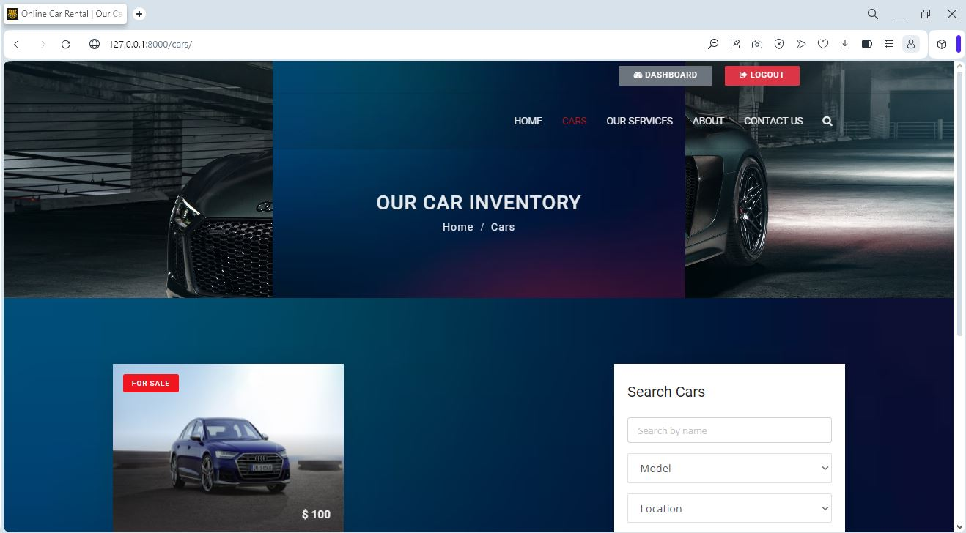
Cars-Page

Slide 15
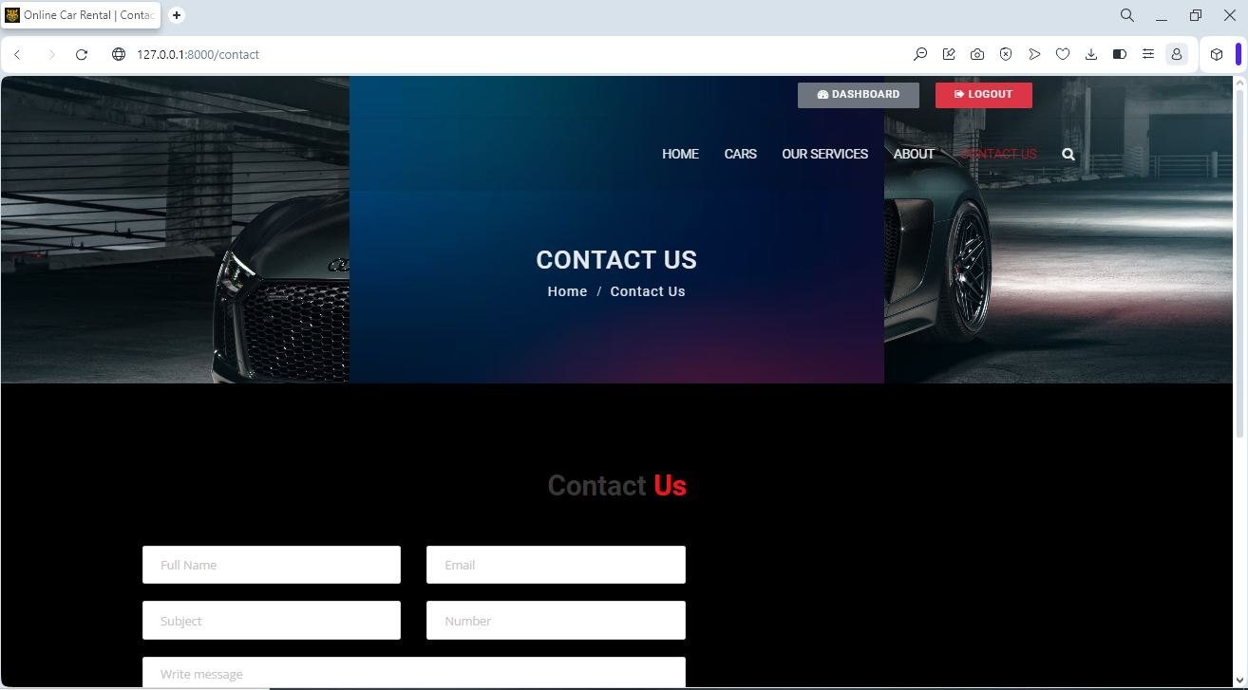
Blog-Page

Slide 16
Future Enhancements:
In future iterations of our car rentals application built with the Django framework, we envision implementing several enhancements to elevate the user experience and functionality. One key aspect we aim to explore is the integration of artificial intelligence (AI) capabilities, such as predictive maintenance algorithms to anticipate and prevent vehicle issues before they occur, and personalized recommendation systems to suggest rental options tailored to individual preferences. Additionally, we plan to develop a companion mobile app for iOS and Android platforms, extending the convenience of booking and managing rentals on the go.

Slide 17
Conclusion
In conclusion, leveraging Django framework for a car rentals application offers robustness, scalability, and security. Its flexibility allows for seamless integration of features like user authentication, booking management, and inventory tracking. With Django's extensive ecosystem and community support, the application can continuously evolve with enhancements like recommendation systems, payment gateways, and real-time GPS tracking to provide a superior user experience. Overall, Django serves as a solid foundation for building a modern and efficient car rental platform.
Source :

Slide 18
Thank You!
Notes:
Thank You !!

